Slide 1

De-icer
A new product for the de-icing market

Slide 2
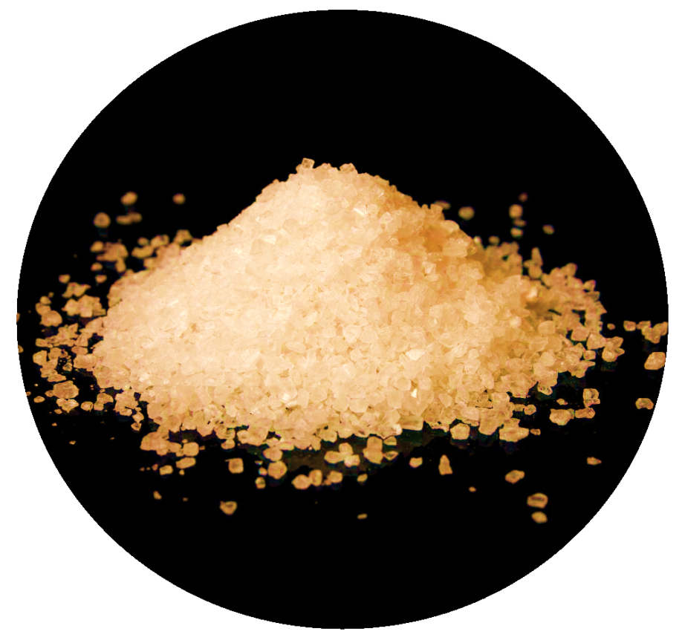
A new product for the De-icer market
Holz RIVA presents a newly developed, research-based and tested, high-performance de-icing mixture.
Composition of the de-icer mixture: sodium chloride, molasses, urea, additional corrosion inhibitor.

Slide 3
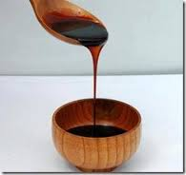
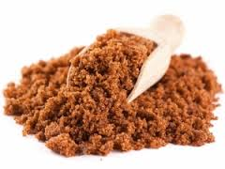
Molasses is the end product derived from sugar beets by separating sugar crystals in a centrifuge
Molasses is a world-known material used to eliminate the slipperiness of road pavement and as a corrosion inhibitor.
Molasses-based De-icer mixtures have been developed and successfully used since 2005.
Molasses-based mixtures are reported to have the following characteristics:
reduce corrosion activity down even by 45 %;
prevent new ice from forming and remain effective up to 7 times longer than ordinary road salt.
Tried in the following countries: USA, Canada, Austria, Sweden, Switzerland, Poland, Germany, United Kingdom, Slovenia, Norway.

Slide 4
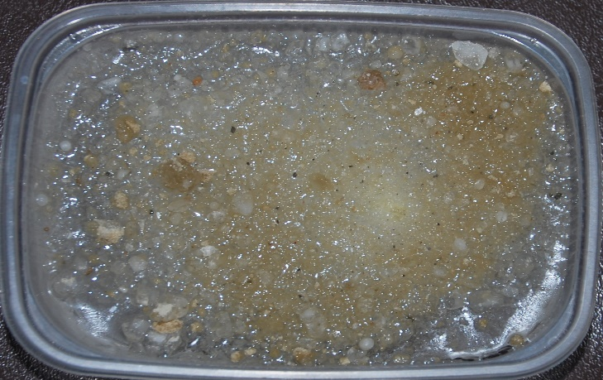
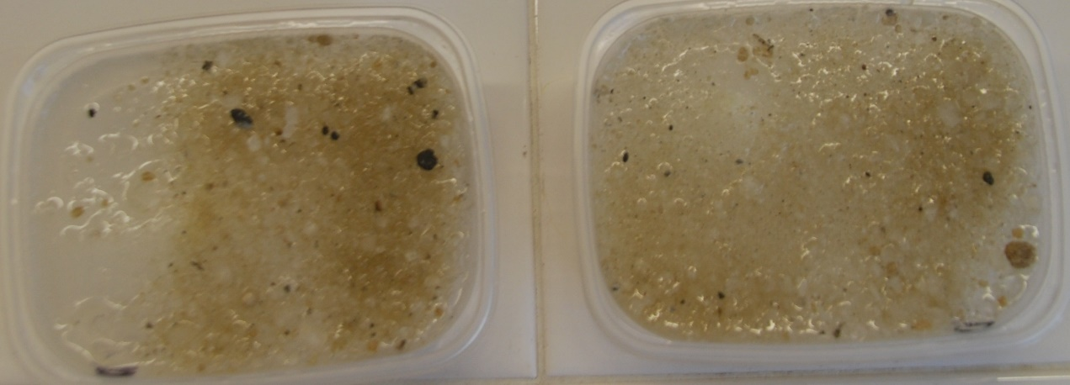
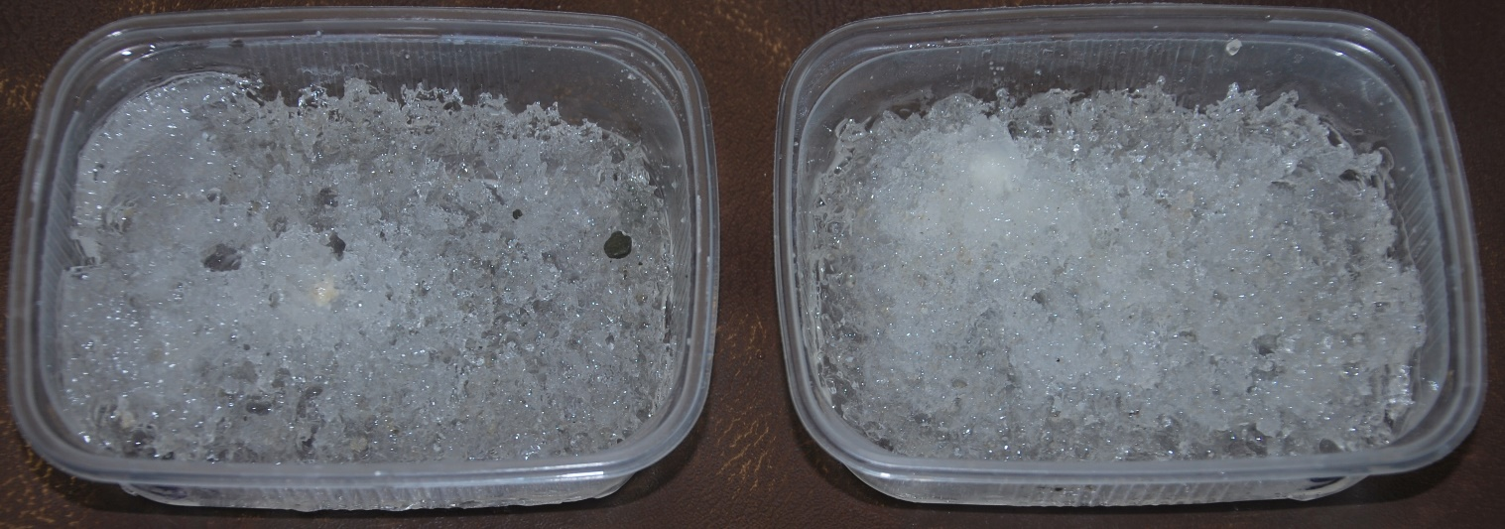
The effects on ice:
After being spread, the mixture penetrates deeply into ice and exhibits long-lasting effect while making ice spongy and porous.
Fig. 1 Ice right after spreading the mixture
Fig. 2 The mixture acts on ice and makes it spongy throughout its entire thickness

Slide 5
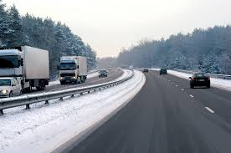
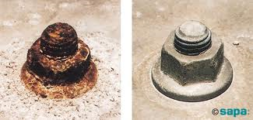
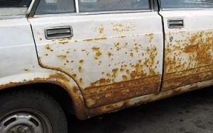
Skid effect test and findings:
The use of mixture containing up to 5 % of molasses was found to prevent film formation; therefore, the mixture cannot cause the skid effect.
Metal corrosion tests and findings:
De-icer product with inhibitors contained therein:
Reduces corrosion by up to 32 times when compared to road salt;
Significantly reduces negative effect on metal, metal structures and concrete.

Slide 6
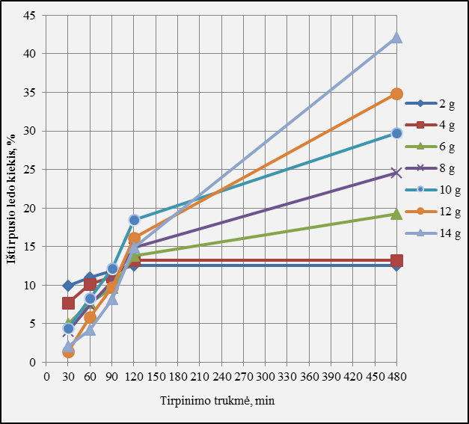
De-icer spreading rates
The ice melting rate was measured by spreading different amounts of the de-icer product mixture on ice cubes of 2 cm at the air temperature of -15°C and assessing ice reduction 30, 60, 90, 120 and 480 min. later.
According to experimental laboratory data, the recommended optimal spreading amount is ~13 g/m².

Slide 7
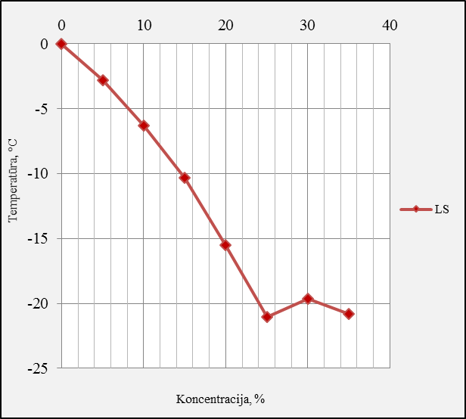
Determination of the crystallisation temperature
Studies have shown that the moist mixture De-icer product outperforms the dry mixture by up to 8 %.
The most suitable product for moistening De-icer product is De-icer product 25% solution or road salt solution.
The crystallisation temperature of the De-icer product solution is ~ -22 °C.

Slide 8
Granulometric composition: De-icer vs. road salt (NaCl)
No. | Granule size | Sodium chloride | De-icer
1 | >5 mm | 0.9 | 1.7
2 | <0.16 mm | 3.6 | 0.2
3 | 2-5 mm | 52 | 40.8
4 | 0.71-2 mm | 37.9 | 35.7
5 | 0.16-0.71 mm | 5.6 | 21.6
6 | <0.063 mm | 1.1 | 0
7 | >5 mm+<0.16 mm | 4.5 | 1.9
The mixture is dust free (<0.063 mm particles) which is eliminated in the process of manufacturing. This enables even distribution of the product over the pavement.

Slide 9
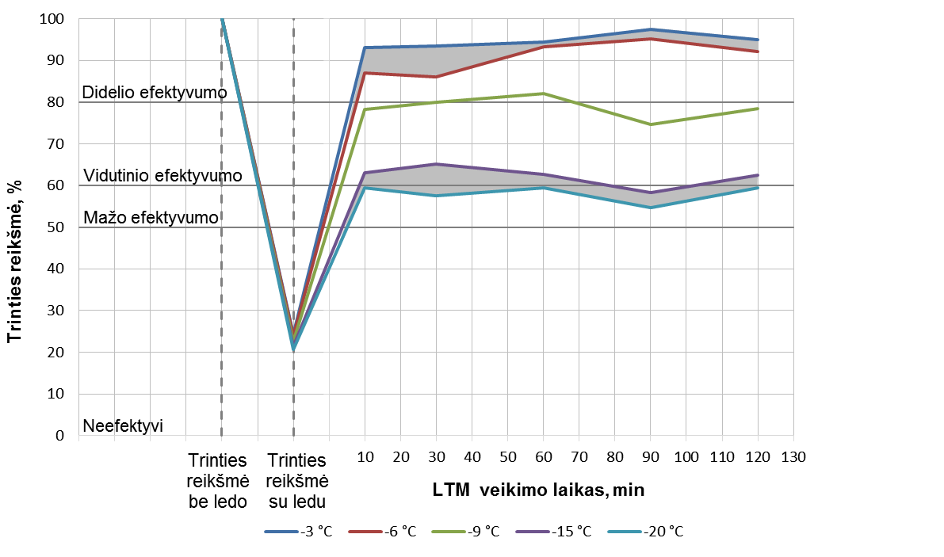
Testing the effects of anti-slip substances on friction:
The De-icer product mixture is of high and medium efficiency according to the intervals chosen by researchers;
De-icer product has by ~20% higher friction value when compared to other test substances attributed by their indicators to low-efficient or inefficient substances.

Slide 10
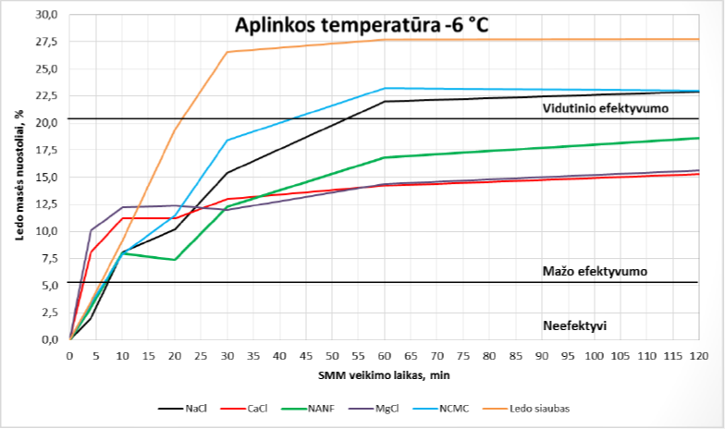
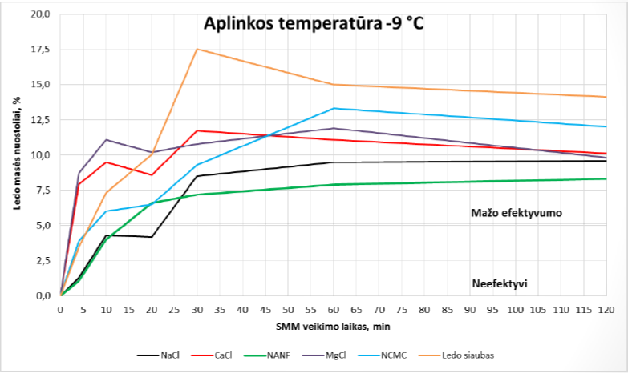
Efficiency evaluation results (for ice-mass loss)
The efficiency of the De-icer product mixture is exhibited by its extremely quick performance;
During the first 30 min., De-icer product melts almost twice as much ice than sodium chloride.

Slide 11
What benefits do we get with De-icer?
Less kilometres worked for spreaders,
Dust-free mixture De-icer can be evenly distributed and stays for up to 25 % longer on the pavement thus reducing the number of voyages for spreaders;
Lower road and machinery maintenance costs,
Three components with inhibiting properties result in up to 32 lower corrosion rates when compared to pure sodium chloride solutions of the same salinity. This significantly reduces negative effects on metals and metal structures;
More environmentally-friendly De-icer
Molasses and urea additives exhibit good anti-corrosive properties, compensate negative effects of salt on plants and soil, and contribute to snow and ice melting in lower temperatures (up to -25 °C).

Slide 12
De-icer– an innovative and cost-efficient guarantee of high-quality maintenance standards for roads
De-icer safe and reliable!
Your reliable supplier :
Reg. number – 300518056
VAT Nr : - LT 100002158012
Office – K.Donelaičio 24-405 , Kaunas , LT 44239
Tel. +370 37 221363
Fax +370 698 51397
E-mail : info@holzriva.eu
Director : Rimantas Andrikonis

